Slide 1
SHADERS
A PRACTICAL GUIDE

Slide 2
What do I mean by Practical Guide?
By the end of this talk, you’ll be able to answer these questions:
What exactly are shaders?
What’s the actual purpose of it?
Should you even write shaders on your own?
A proper roadmap of learning Shaders
What is the purpose of Shaders inside Flutter?
How Flutter rendering works?

Slide 3
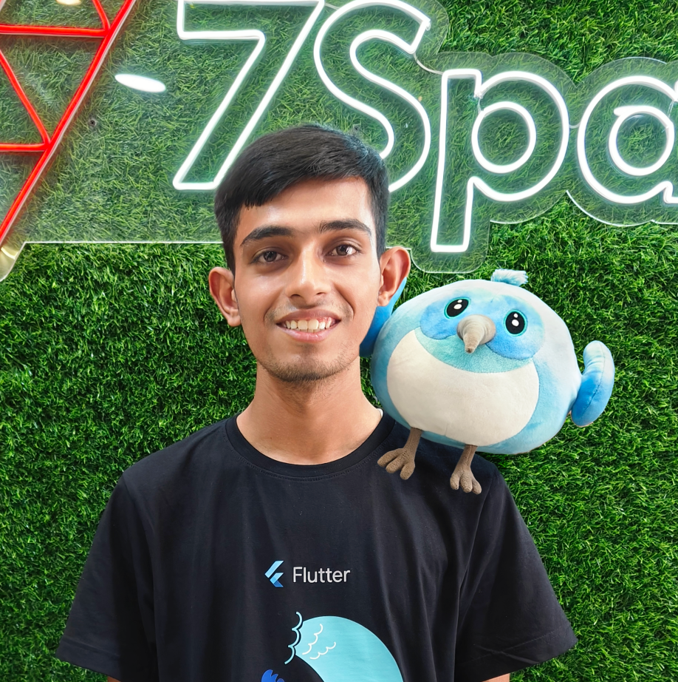
WHO AM I
🔤 My name is Cavin Macwan
👨‍💻 Flutter Developer at 7Span
✍️ Blogger and Speaker 🗣️
💙 Finished #100DaysWithFlutter
🏀 Has been National Basketball Player
🤩 Google “Cavin Macwan” to see my people card 😊

Slide 4
01
02
03
Example
What are Shaders?
Why do we need it?

Slide 5
All functions or variables used in this project are imaginary. The errors that come while compiling can be baseless. Do not pay much attention to them or let them affect your life.
इस प्रोजेक्ट में प्रयोग किये गये सभी फंक्शन या वेरिएबल कालपनिक है। कंपाइल करते समय आने वाले एरर बे-बुनियाद हो सकते हैं। उनपे ज्यादा ध्यान ना दे या ना ही उनका असर अपने जीवन में होने दे।
DISCLAIMER
जनहित में जारी

Slide 6
01
What are Shaders?
Shaders are not as much hard as we think 😉

Slide 7

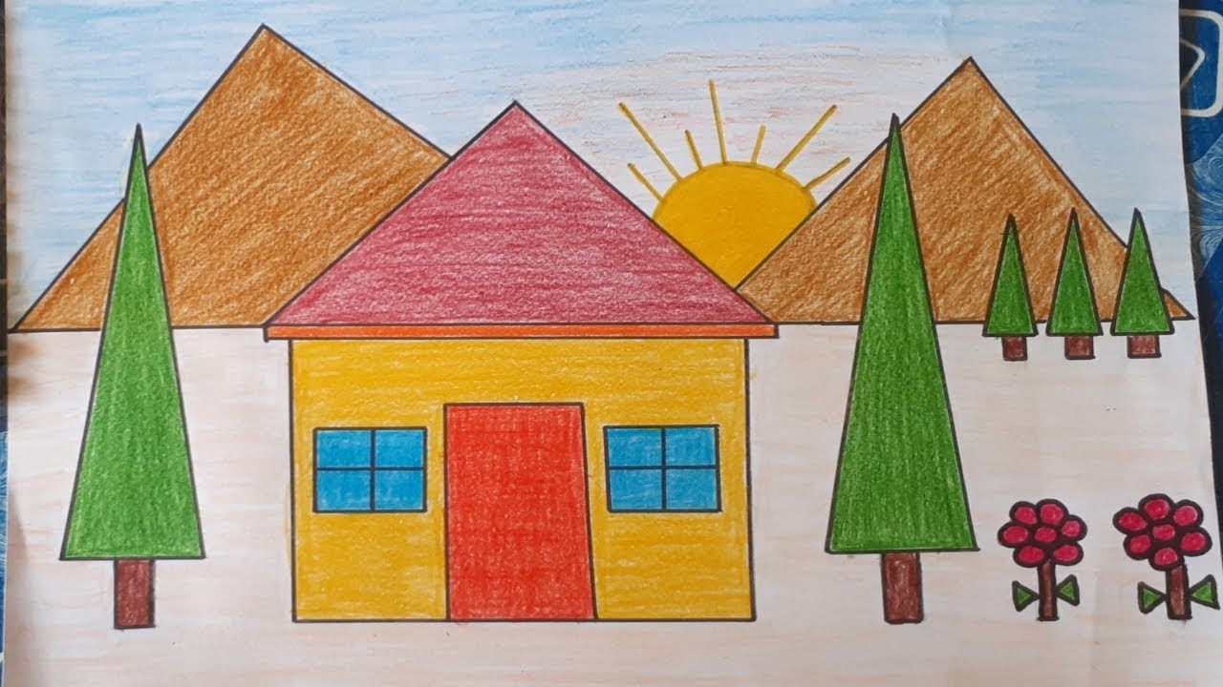
Remember this?

Slide 8
What did you noticed in those pictures?
Childhood of course 😄
First picture is colored but the second one is not
Both are simple to draw (Not for me 😅)
In both of the images, we’re getting some sort of instructions to do something

Slide 9

You already know about the Shaders now 🎨
Shaders are programs that are executed all at once for every single pixel on the screen
It is written in GLSL. It stands for openGL Shading Language, which is the specific standard of shader programs
But……

Slide 10
02
Why do we need it?

Slide 11
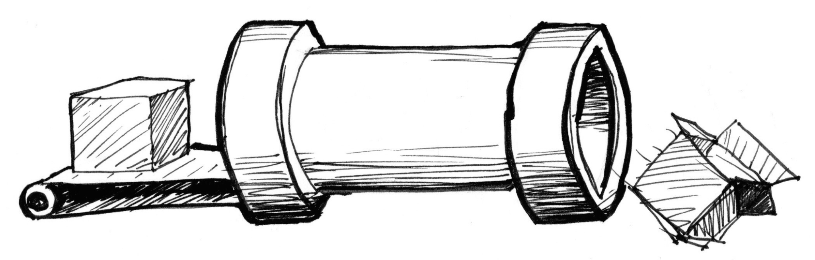
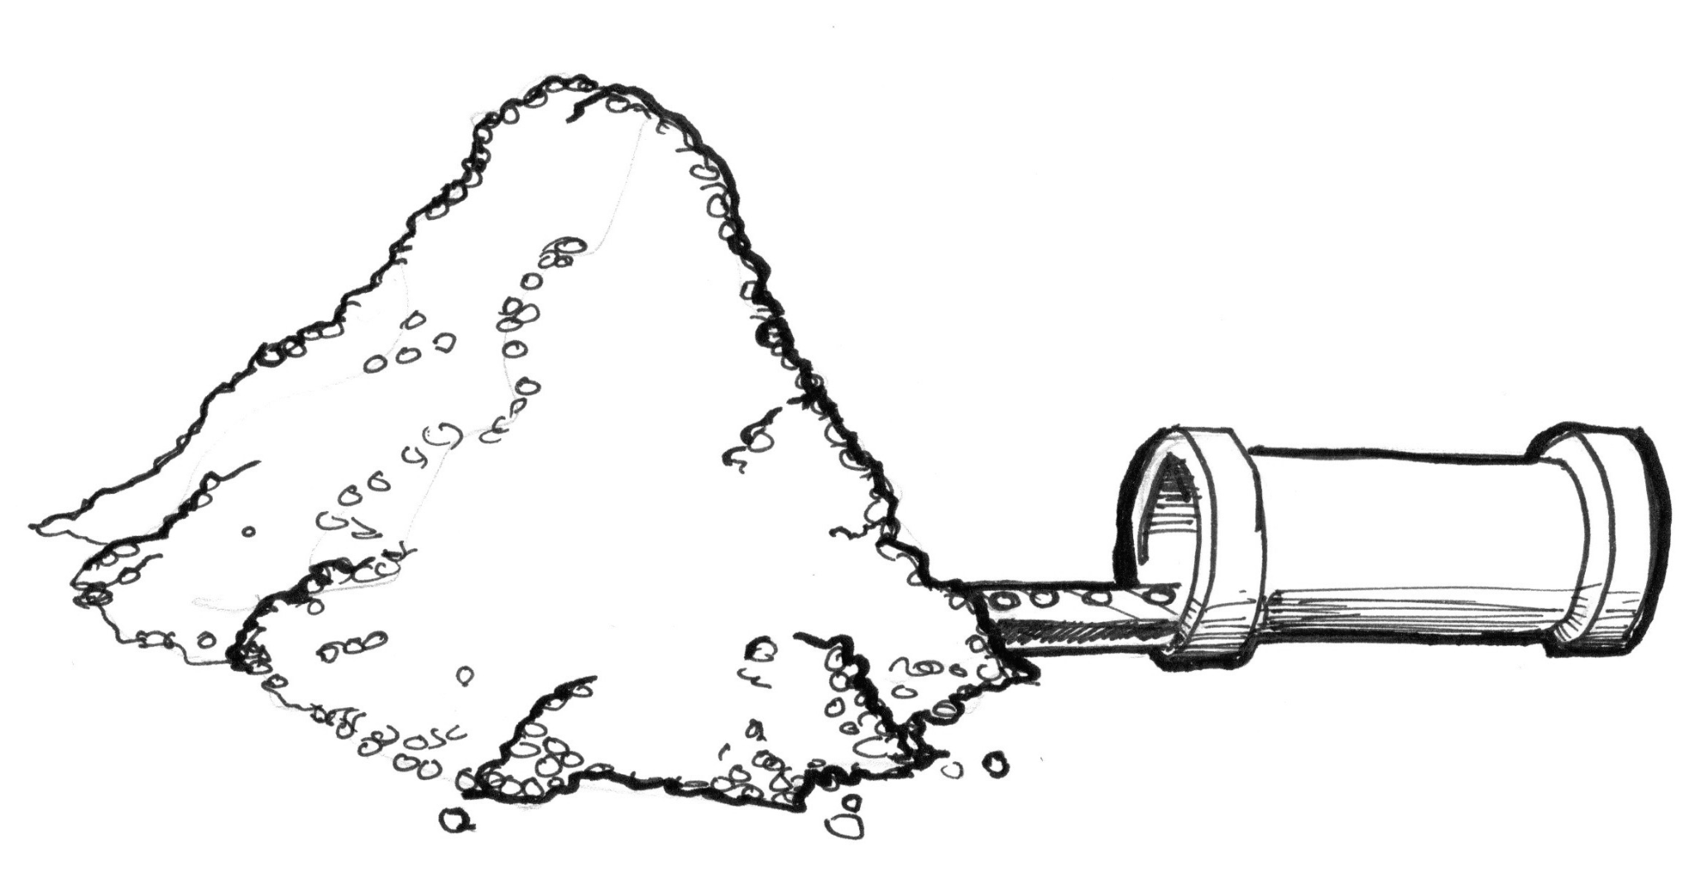
Imagine your CPU like a pipe
Single Process
Multiple Process

Slide 12
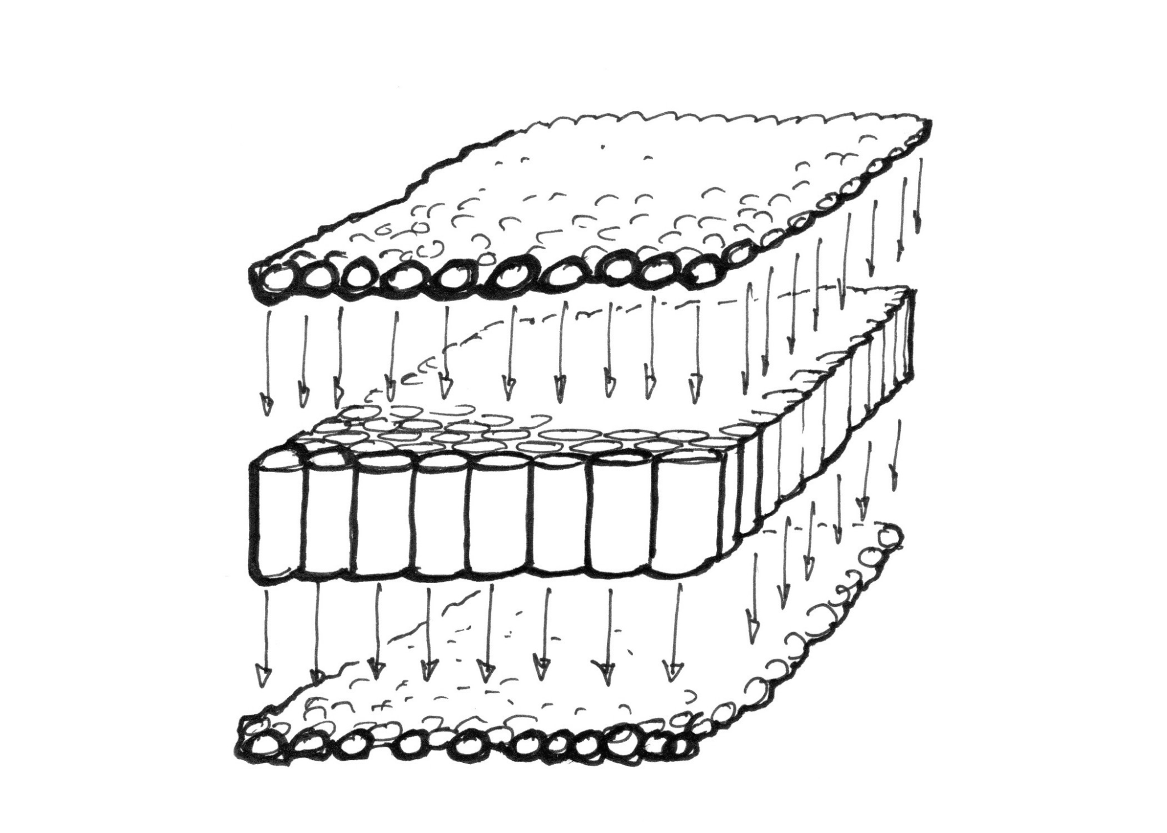
While GPU is being like 😎

Slide 13
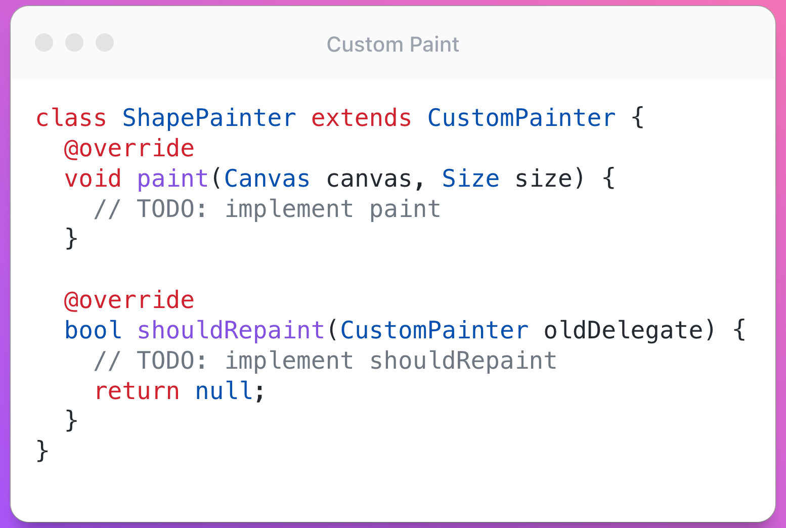
How does Flutter Renders anything? 🤔
WIDGETS
RENDER OBJECT
SHADER
ELEMENTS
CANVAS
PIXELS

Slide 14

That means we’ve to learn another language?

Slide 15
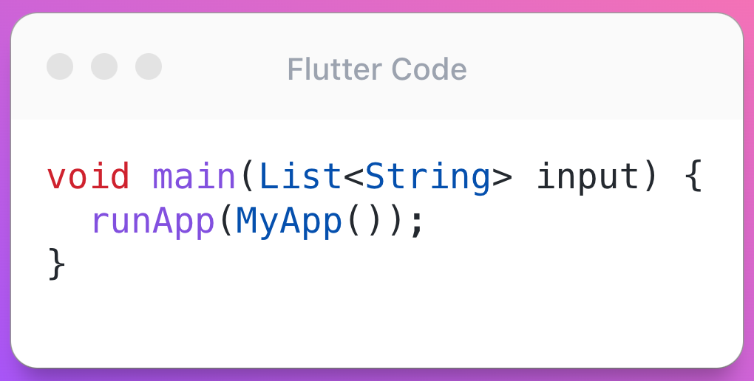
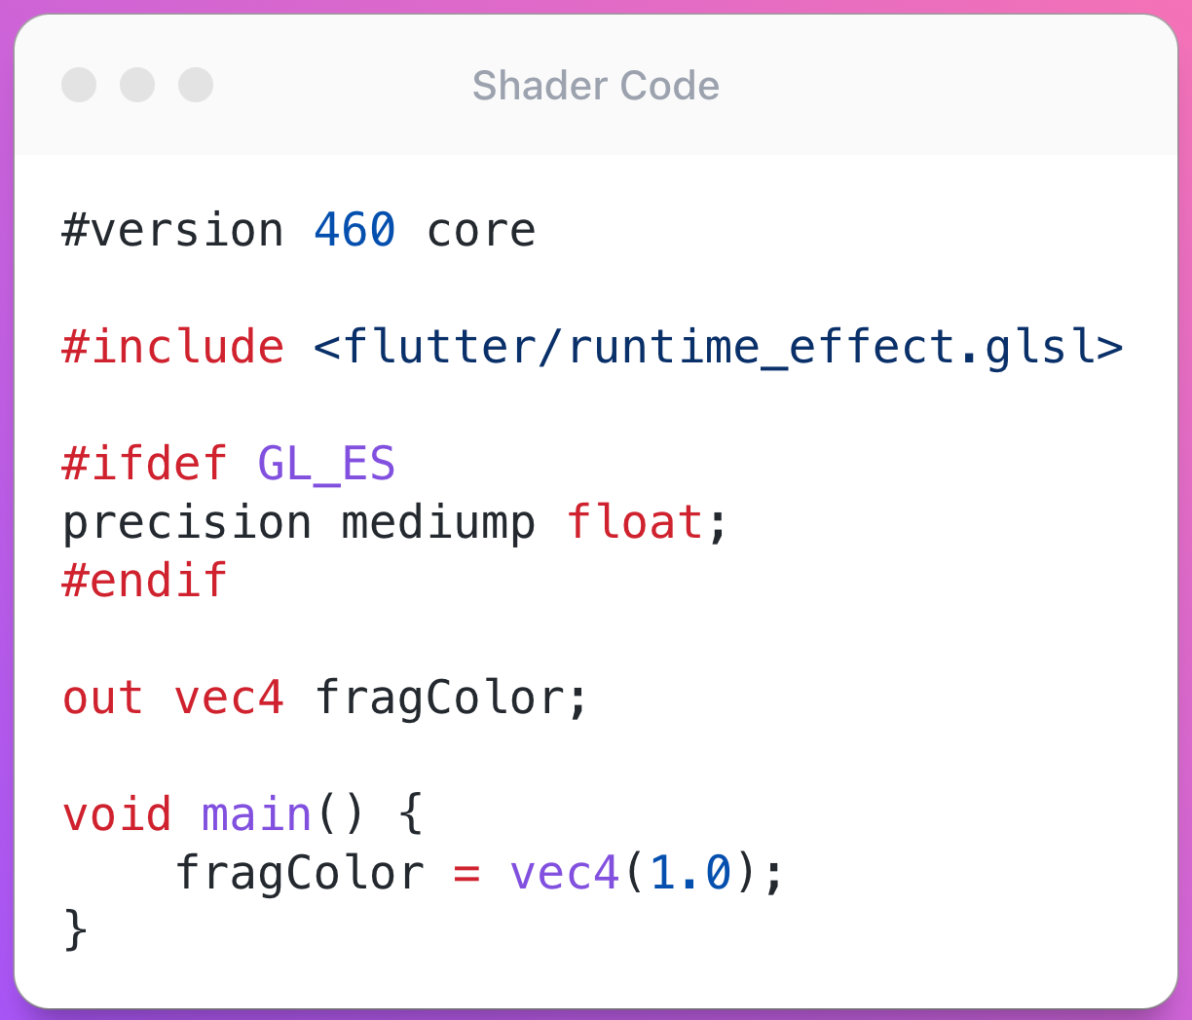
Let’s look at the difference between Dart code and GLSL code

Slide 16

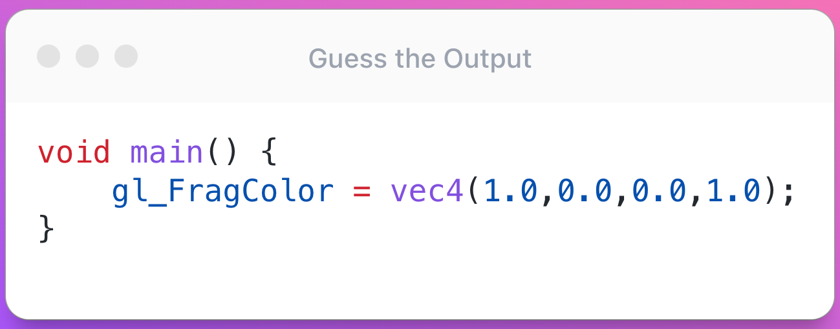
Let’s look at the code of Hello World for Shaders

Slide 17
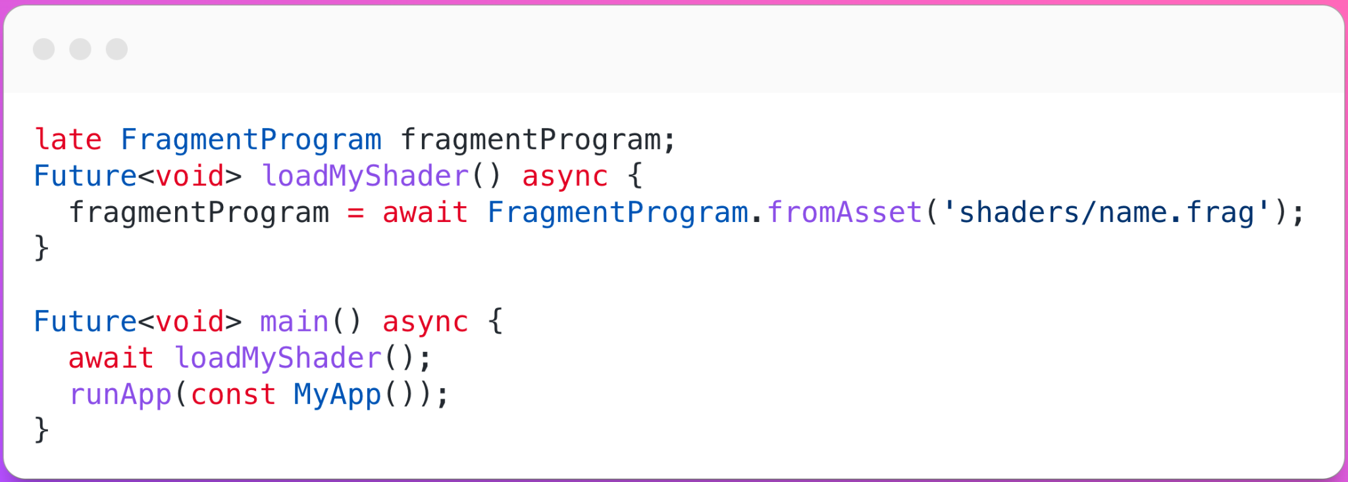
Steps to implement Shaders in Flutter
Step - 1
Global Variable
Load the Shader

Slide 18
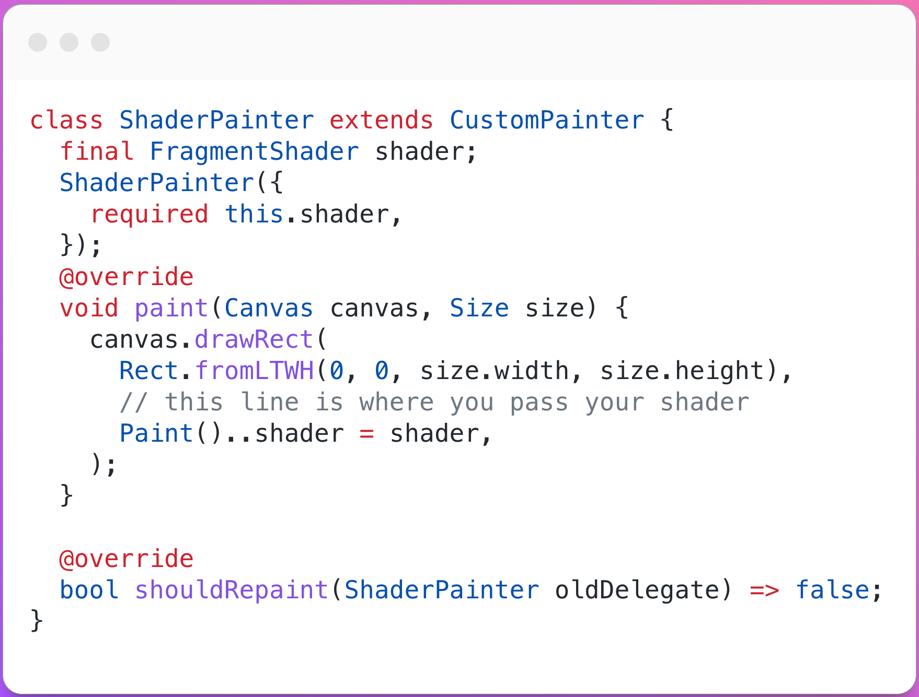
Step - 2
Pass the shader from global variable

Slide 19
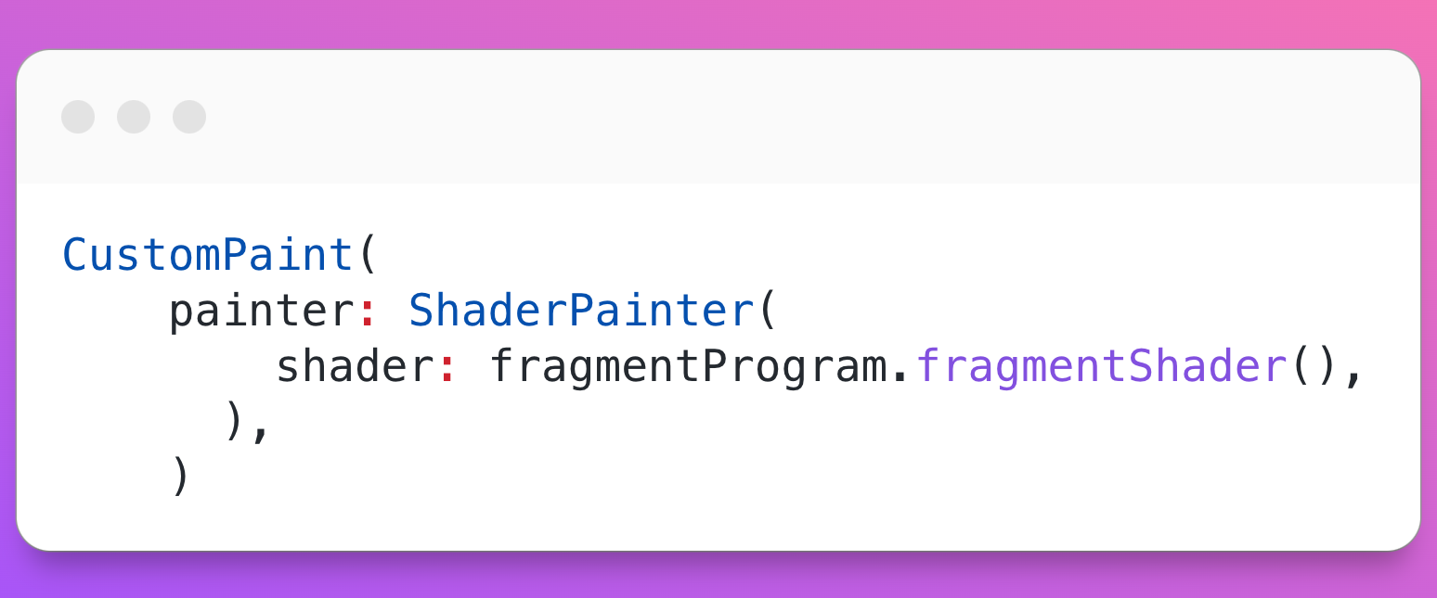
Step - 3
Pass the shader from global variable

Slide 20
Roadmap to learn Shaders like a pro 😎
Shaders in Flutter: Link
The Book of Shaders: Link
GraphToy: Link
Shader Toy: Link
Shader Introduction: Link

Slide 21
“ Make it work, make it right, make it fast ”
— Not by me

Slide 22


Let’s connect
cavin-macwan
cavin_1910

